Slide 1
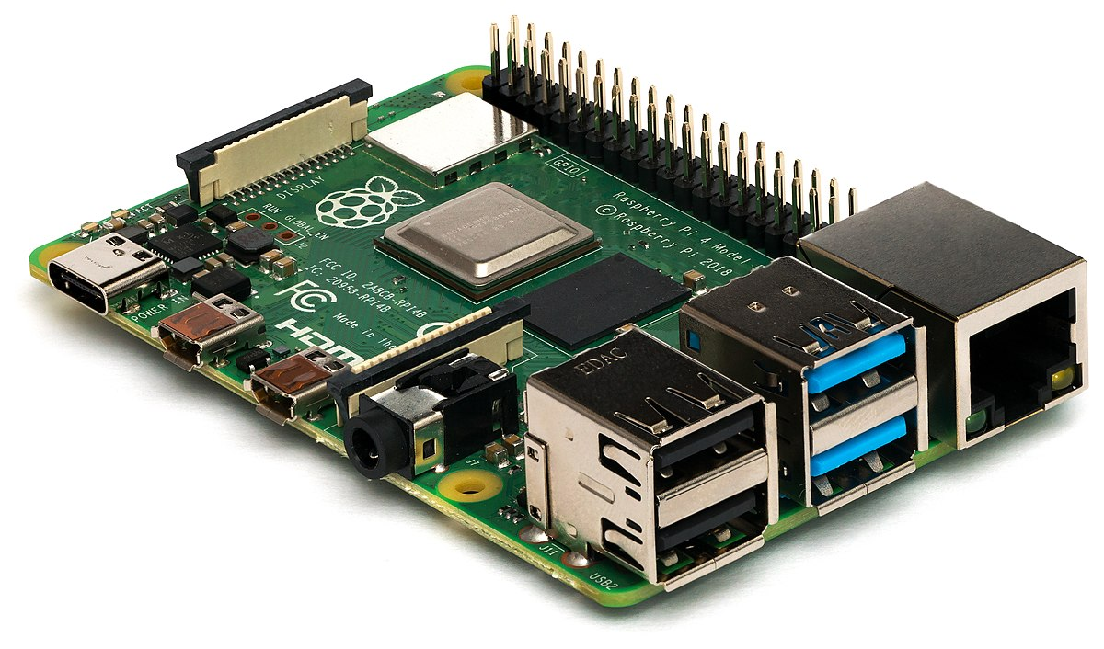
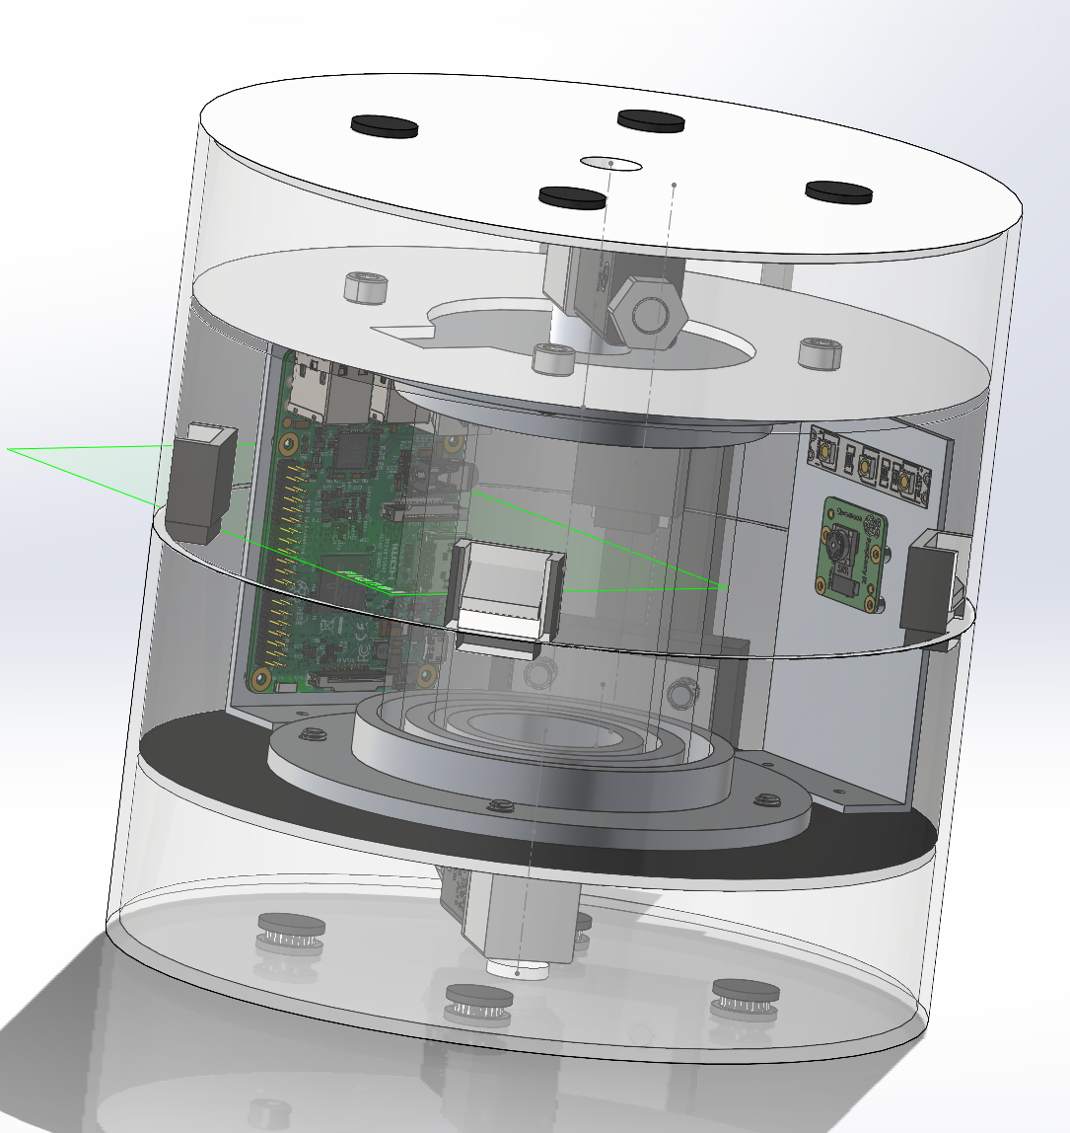
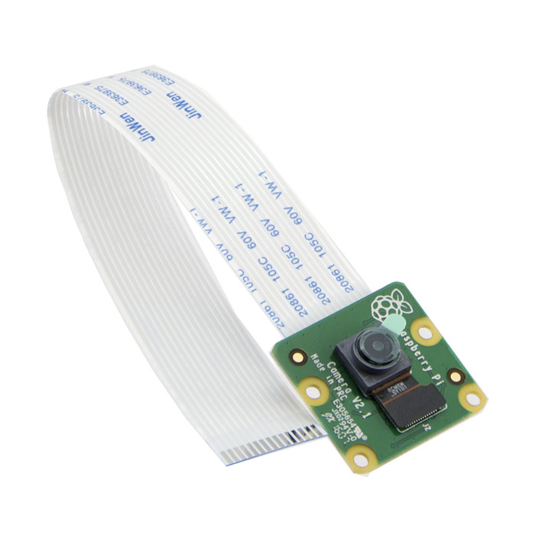
Raspberry Pi + Camera

Slide 2
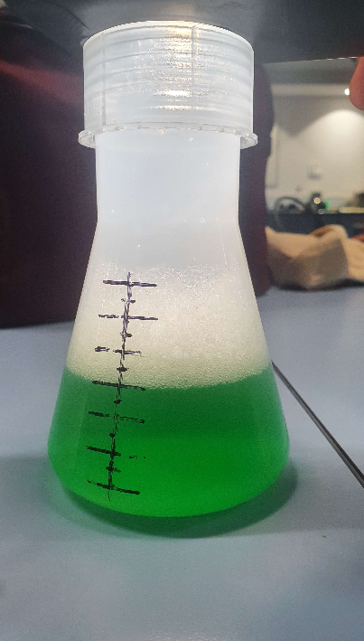
Digestate Image Analysis
Original

Slide 3
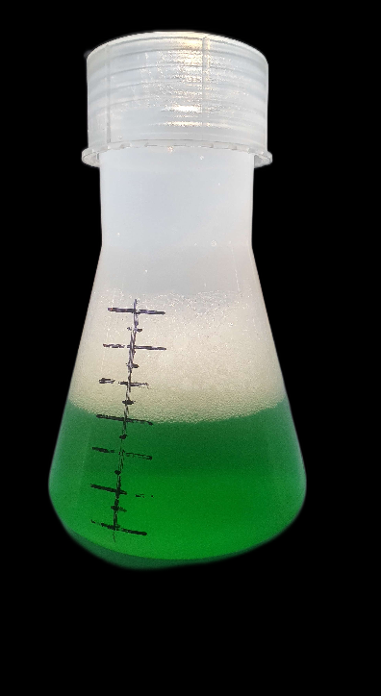
Digestate Image Analysis
Original
Background Removed

Slide 4
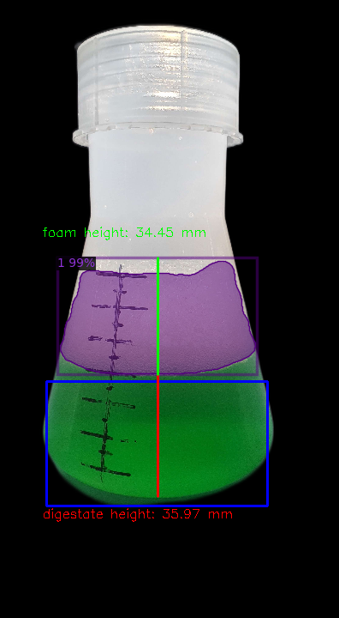



Digestate Image Analysis
Original
Background Removed
Analysed
Foam Colour
Digestate Colour

